Slide 1
Computer Vision
CNN Architecture and Transfer Learning
- Harigovind S Menon

Slide 2




Introduction to Computer Vision
Computer vision is a field of artificial intelligence that trains computers to interpret and understand the visual world. Machines can accurately identify and classify objects — and then react to what they “see” in digital images using deep learning models.
Some of the most common use cases of computer vision in different industries:
Retail
Retailers can use computer vision to enhance the shopping experience, increase loss prevention and detect out-of-stock shelves. Computer vision is already helping customers checkout more quickly
Manufacturing
In manufacturing, businesses use computer vision to identify product defects in real time. As the products are coming off the production line, a computer processes images or videos, and flags dozens of different types of defects — even on the smallest of products
Public Sector
Public sector agencies use computer vision to better understand the physical condition of assets under their control, and can help agencies perform predictive maintenance by analyzing equipment images to better determine maintenance requirements
Healthcare
Computer vision systems examine imagery from MRIs, CAT scans and X-rays to detect abnormalities as accurately as human doctors. Doctors also use neural networks on three-dimensional images like ultrasounds to detect visual differences in heartbeats and more

Slide 3
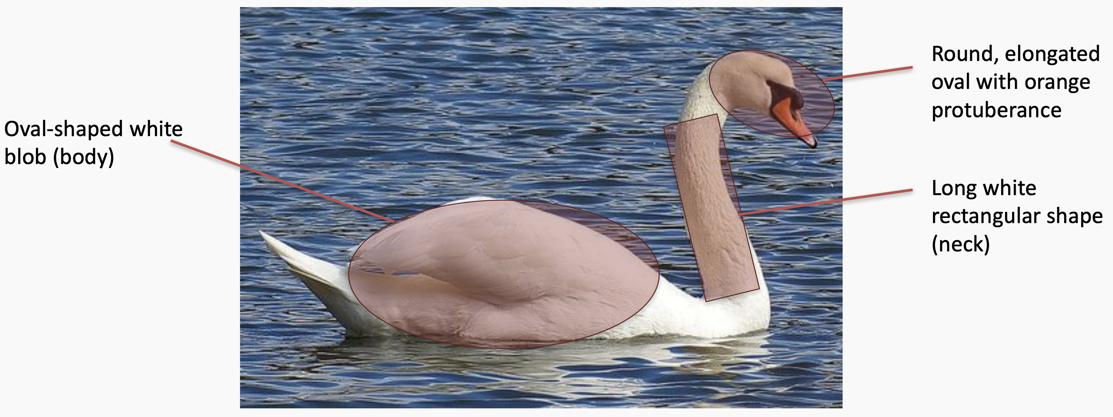
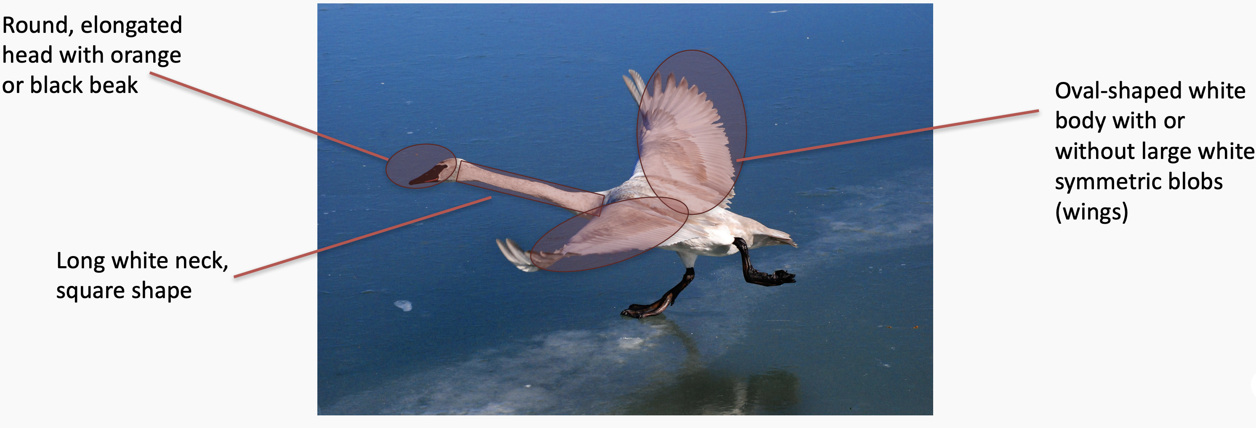
Introduction to CNN
Learn to detect the features from the image – Representation learning
Why CNN over MLP?
The amount of weights become unmanageable for large images with MLPs
MLPs are not translation invariant
Spatial information is lost when image is flattened for MLPs
CNNs leverage the fact that nearby pixels are more strongly related than distant ones

Slide 4

What is a filter/kernel?
CNNs work by performing a convolution operation on a patch of cells (defined by the kernel size). Instead of analysing each pixel, a set of pixels are taken. This helps understand the influence of a region of pixels.
The specified filter moves all over the image (top left to bottom right) and the output is sent to subsequent layers

Slide 5

Important layers in a CNN model architecture
Convolution layer: The output feature map is generated through a convolution operation of filters on the input feature map
Pooling layer: Select specific values (usually average or max) on the feature maps and use these as inputs to subsequent layer
Activation layer: Decides whether a certain feature (values) should go into the next layer based on a function (usually ReLU)
Fully connected layer: The final feature map is flattened and a FC layer is formed with the classifier layer

Slide 6
Transfer Learning

Slide 7
What is Transfer Learning? And why is it useful?
Conventional deep learning algorithms have been designed to solve specific tasks. The models have to be rebuilt from scratch once the feature-space distribution changes. Transfer learning is the idea of overcoming the isolated learning paradigm and utilizing knowledge acquired for one task to solve related ones
In Computer Vision, the first few layers of a CNN model detect lines, shapes, outlines, foreground/background identification etc. These are largely similar in most models irrespective of the task.
The final layers are tuned to be specific to the training images. By retraining just the final layers to fine tune towards identifying the new set of images, we have a model that can identify the new set of classes with a high accuracy.

Slide 8
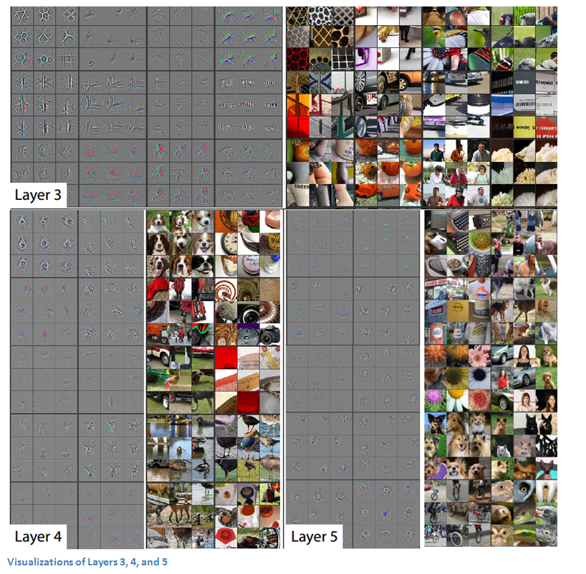
How does Transfer Learning work?

Slide 9
Modelling Pipeline for Transfer Learning
Preprocess Images
Inference
Loading the model
Preprocess the training, validation and testing images to resemble the input of the pre-trained model
Perform needed data augmentation
Retrain final layers
Use the trained model to make the predictions
Create the output in the desired format
02
Identify the number of layers that needs to be retrained
The closer the images are to the original images, the lesser the number of layers that need to be retrained
04
Identify and load the selected pre trained model
Print the model summary and identify the layers of the model
01
03

Slide 10
Appendix

Slide 11

What is the output of a convolution operation?
If the input for convolution operation is of the dimension L*W*D, where L and W are the spatial dimensions and D is the depth, then the filter depth should also be D
Back

Slide 12
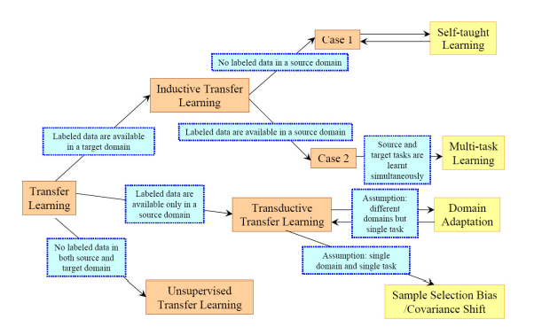
Transfer Learning Strategies
Inductive Transfer learning: In this scenario, the source and target domains are the same, yet the source and target tasks are different from each other. The algorithms try to utilize the inductive biases of the source domain to help improve the target task.
Unsupervised Transfer Learning: This setting is similar to inductive transfer itself, with a focus on unsupervised tasks in the target domain. The source and target domains are similar, but the tasks are different.
Transductive Transfer Learning: In this scenario, there are similarities between the source and target tasks, but the corresponding domains are different. In this setting, the source domain has a lot of labeled data, while the target domain has none.

